Slide 1
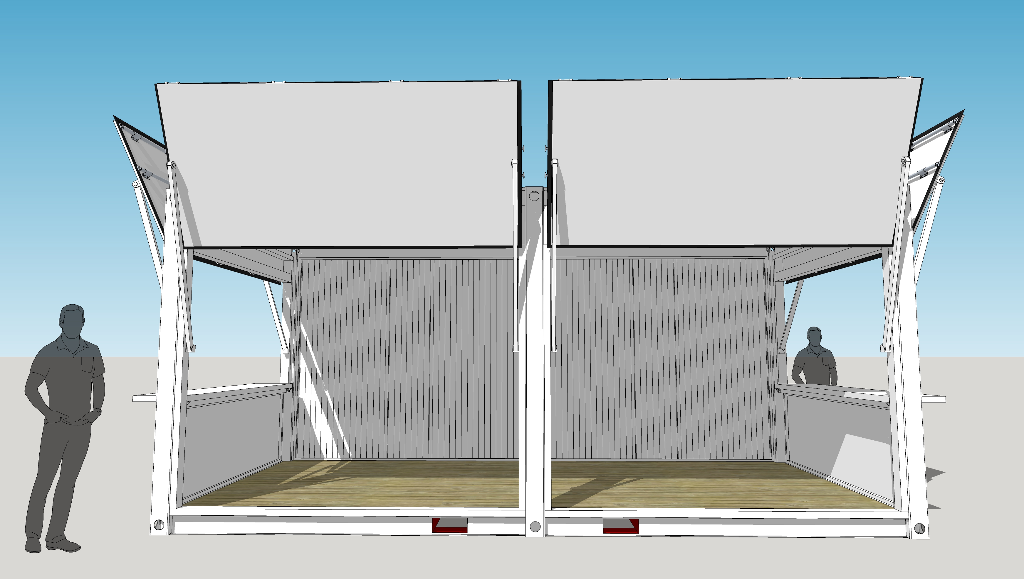
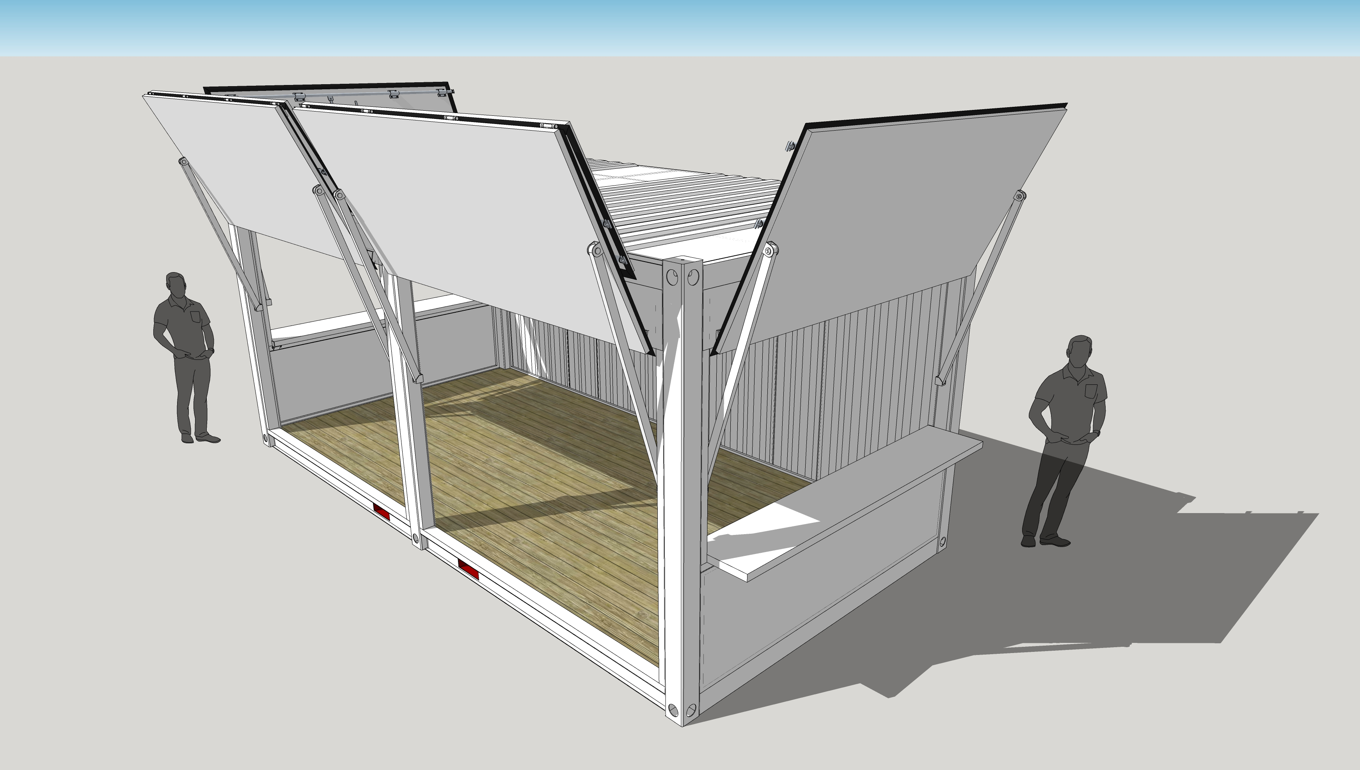
1,150mm
3,000mm
6,000mm
2,700mm
6,000mm
3,000mm

Slide 2
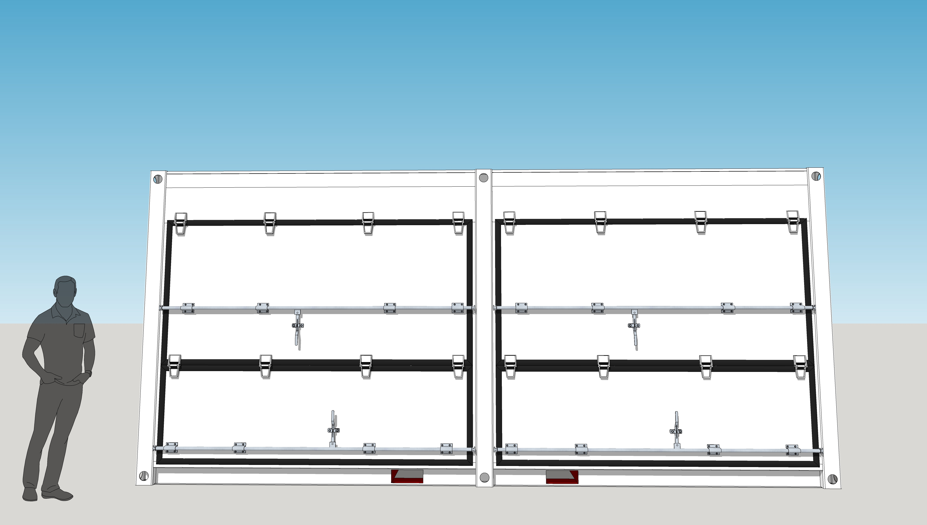
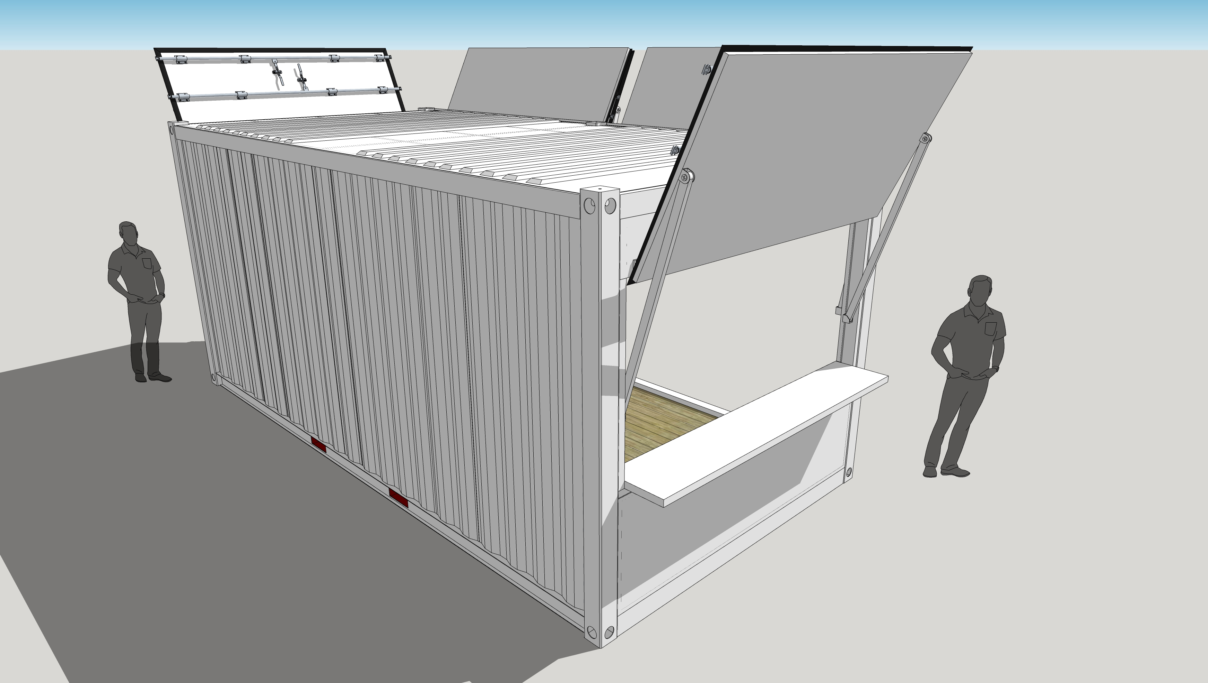
2,700mm
6,000mm
1,150mm
6,000mm
3,000mm

